Slide 1

AI-Driven Strategic Risk Management
In Hybrid Project Environments

Slide 2

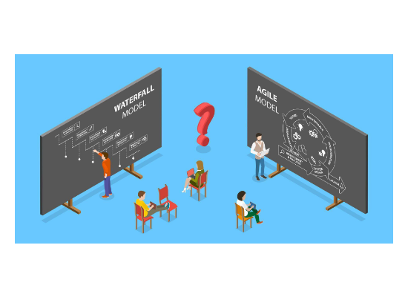
Problem Statement
The Core Conflict: Hybrid project environments combine Agile and Waterfall practices, but their risk cycles don’t align. Agile teams manage risks continuously, while Waterfall teams follow periodic reviews.
This misalignment creates:
•
Fragmented risk visibility
•
Delayed escalation
•
Inconsistent mitigation actions
•
Higher project volatility
Existing frameworks don’t provide a unified approach to detect, assess, and respond to cross-methodology risks in real time.

Slide 3
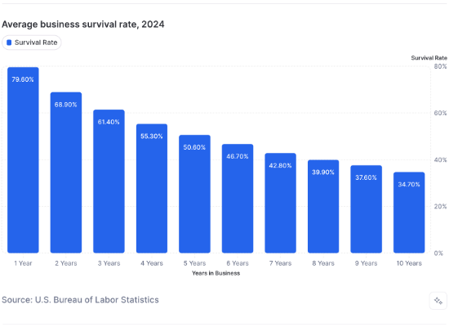
Why This Problem Is Real
Widespread Adoption: By 2025, over 45–55% of large organizations will use hybrid delivery models.
Recurring Failures: PMI reports failures linked to misaligned risk processes and unclear accountability.
Signal Conflicts: Agile identifies risks early, while Waterfall escalates late, causing integration conflicts.
Structural Gap: Hybrid environments amplify complexity, yet practices haven’t evolved to match it.

Slide 4

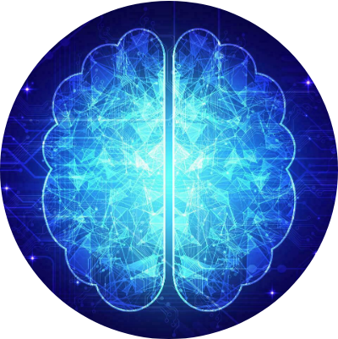
Research Aim
"To develop and validate an AI-based strategic risk-management framework that unifies Agile and Waterfall risk signals."
Enabling earlier detection, adaptive responses, and consistent governance across hybrid project environments.

Slide 5
Research Objectives
Identify Inconsistencies: Pinpoint key risk-management gaps between Agile and Waterfall teams.
Analyze Impact: Understand how these inconsistencies disrupt hybrid project outcomes.
Explore AI Techniques: Investigate predictive analytics, NLP, and anomaly detection for better visibility.
Design Framework: Create an AI-supported model integrating risk data from both methodologies.
Evaluate & Validate: Test the framework through expert feedback and simulated project scenarios.

Slide 6
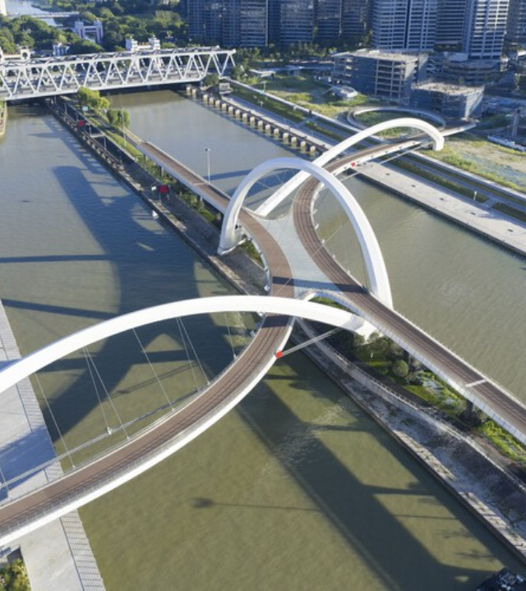
Expected Contribution
A practical, AI-enabled risk-management model that synchronizes Agile and Waterfall workflows.
This unified approach will:
•
Reduce ambiguity in hybrid governance.
•
Improve risk detection timing.
Ultimately offering organizations a structured approach for significantly more stable and predictable project delivery.

